Slide 1


SQL Social Science
Lucia Michielin
Edinburgh University
L.Michielin@sms.ed.ac.uk

Slide 2



Before starting …some practical info
Coffe break
Restrooms
Stickers

Slide 3
Plan of the Workshop
1. What is a relational database
2. Using DB Browser for SQLite
3. The Select Statement
4. Missing Data
5. Creating new columns
6. Aggregations
7. creating tables and view
8. Joins

Slide 4

1. What is a relational database
Questions
What is a relational database?
What is a table?
What is a data type?
Why do tables have key columns?
What different types of keys are there?
How does the database represent missing data?
Objectives
Define a relational database
Compare with other types of databases
Understand the structure of a table
List the SQLite datatypes
Explain the purpose of a Schema
Explain Key fields
Understand the use of NULL

Slide 5

1. What is a relational database
What a Relational Database is?
“A relational database stores data in relations made up of records with fields. The relations are usually represented as tables; each record is usually shown as a row, and the fields as columns. In most cases, each record will have a unique identifier, called a key, which is stored as one of its fields. Records may also contain keys that refer to records in other tables, which enables us to combine information from two or more sources”

Slide 6

1. What is a relational database
What is a table?
As were have noted above , a single table is very much like a spreadsheet. It has rows and it has columns. A row represents a single observation and the columns represents the various variables contained within that observation. The rows may or may not have an index or key column as a means of uniquely identifying a row. The columns typically have a name associated with them indicating the variable name, or in one of the examples we are going to use a question number from a survey. A column always represents the same variable for each row contained in the table.
Because of this the data in each column will always be of
the same type, such as an Integer, or Text value for all rows
in the table. Datatypes are discussed in the next section.

Slide 7
1. What is a relational database
Data type | Description
CHARACTER(n) | Character string. Fixed-length n
VARCHAR(n) or CHARACTER VARYING(n) | Character string. Variable length. Maximum length n
BINARY(n) | Binary string. Fixed-length n
BOOLEAN | Stores TRUE or FALSE values
VARBINARY(n) or BINARY VARYING(n) | Binary string. Variable length. Maximum length n
INTEGER(p) | Integer numerical (no decimal).
SMALLINT | Integer numerical (no decimal).
INTEGER | Integer numerical (no decimal).
BIGINT | Integer numerical (no decimal).
DECIMAL(p,s) | Exact numerical, precision p, scale s.
NUMERIC(p,s) | Exact numerical, precision p, scale s. (Same as DECIMAL)
FLOAT | Approximate numerical
DOUBLE PRECISION | Approximate numerical
DATE | Stores year, month, and day values
TIME | Stores hour, minute, and second values
TIMESTAMP | Stores year, month, day, hour, minute, and second values
INTERVAL | Composed of a number of integer fields, representing a period of time, depending on the type of interval
ARRAY | A set-length and ordered collection of elements
MULTISET | A variable-length and unordered collection of elements
XML | Stores XML data

Slide 8
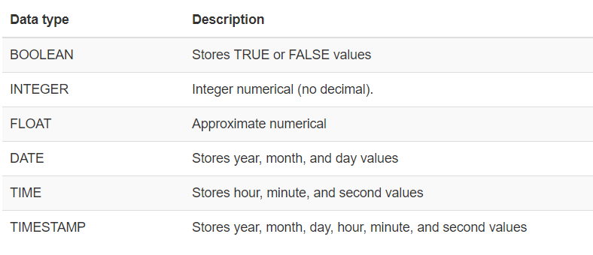
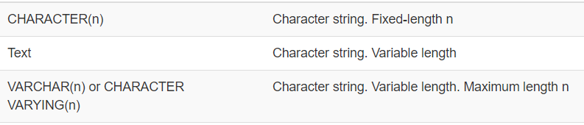
1. What is a relational database

Slide 9

1. What is a relational database
Database Design
Every row-column combination contains a single atomic value, i.e., not containing parts we might want to work with separately.
One field per type of information
No redundant information
Split into separate tables with one table per class of information
Needs an identifier in common between tables – shared column - to reconnect

Slide 10

1. What is a relational database
What is the relationship of your data?
1 to 1: name and Uni ID
1 to n: ID buyer and purchased orders
n to n: Uni ID and class enrolled in

Slide 11
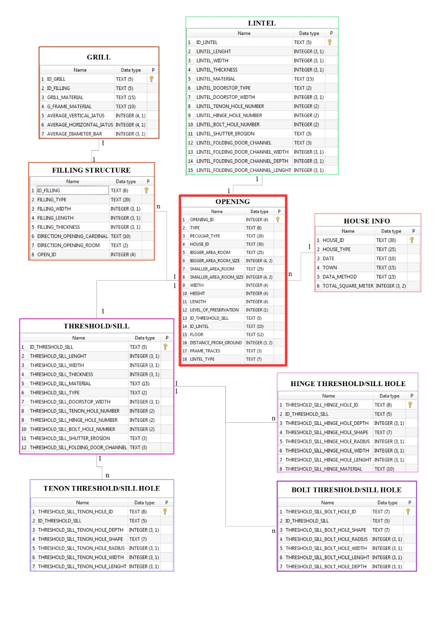

Keying is the key
1. What is a relational database
Primary key
Secondary/Foreing key

Slide 12

1. What is a relational database
How does the database represent missing data?
All relational database systems have the concept of a NULL value. NULL can be thought of as being of all data types or of no data type at all. It represents something which is simply not known.
When you create a database table, for each column you are allowed to indicate whether or not it can contain the NULL value. Like primary keys, this can be used as a form of data validation.
In many real life situations you will have to accept that the data isn’t perfect and will have to allow NULL or missing values in your table.
In DB Browser we can indicate how we want NULL values to be displayed. In SQL queries you can specifically test for NULL values.
We will look at missing data in more detail in a later episode.

Slide 13

2. Using DB Browser for SQLite
Familiarise yourself with the DB Browser interface
Does anyone has the software installed and running? And the the dataset?
https://datacarpentry.org/sql-socialsci//data/SN7577.sqlite

Slide 14
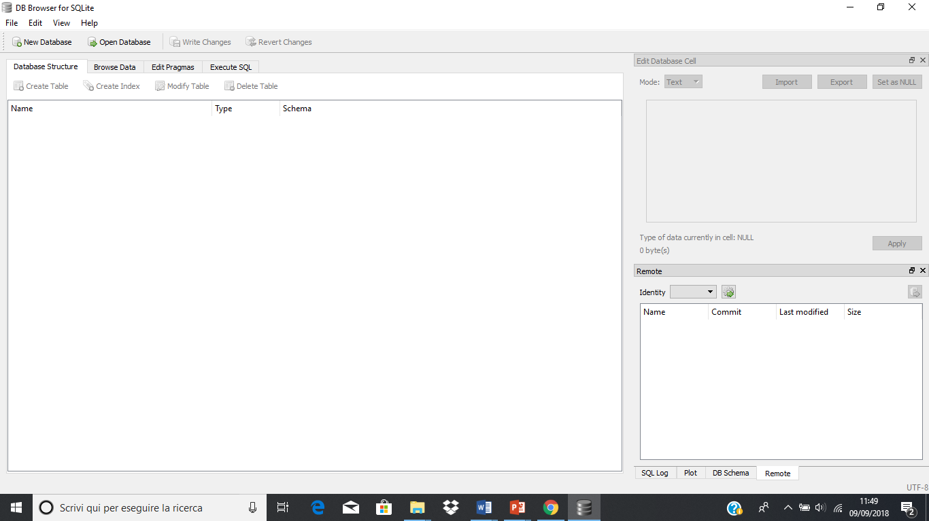
2. Using DB Browser for SQLite
The Initial screen

Slide 15
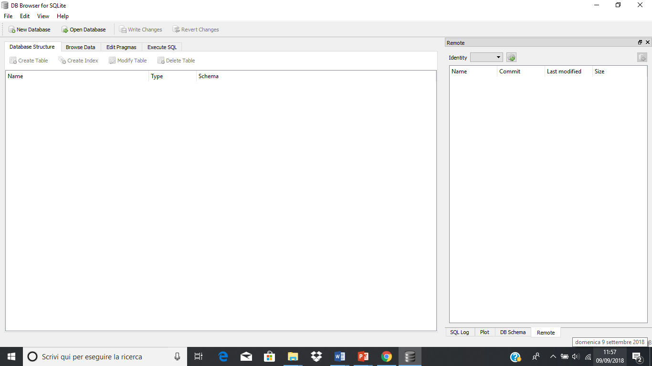
2. Using DB Browser for SQLite
Initial changes to the layout.

Slide 16
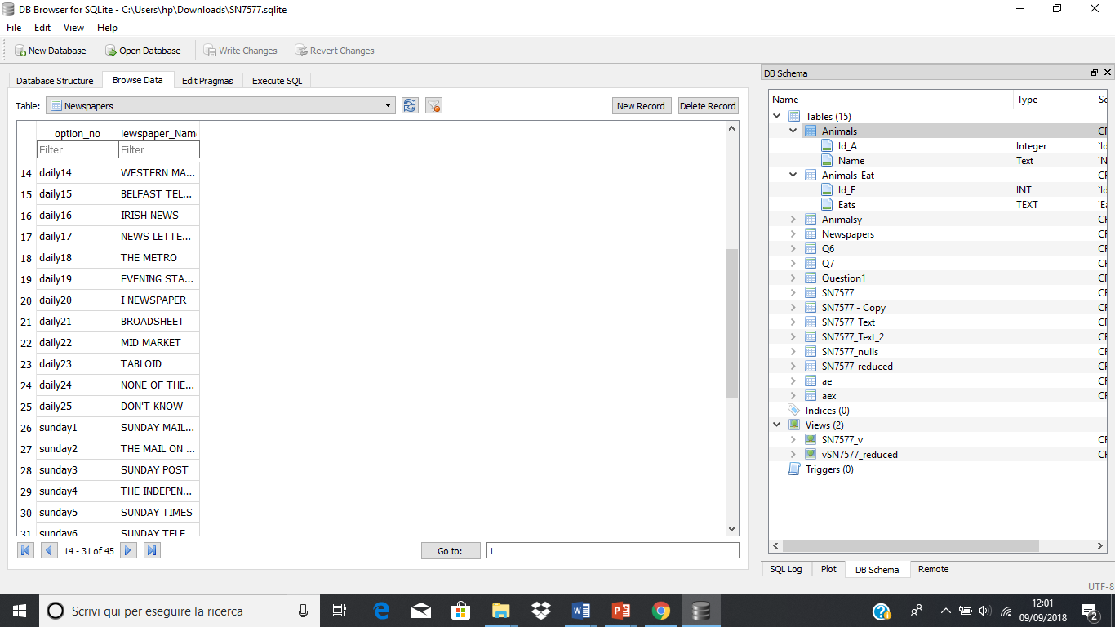
2. Using DB Browser for SQLite
Open an
Existing Database

Slide 17
2. Using DB Browser for SQLite
Quering a database
On the toolbar there are five buttons. Left to right they are:
Open Tab (creates a new tab in the editor)
Open SQL file (allows you to load a prepared file of SQL into the editor - the tab takes the name of he file)
Save SQL file (allows you to save the current contents of the active pane to the local file system)
Execute SQL (Executes all of the SQL statements in the editor pane)
Execute current line (Actually executes whatever is selected)
Always end your query with a ;

Slide 18
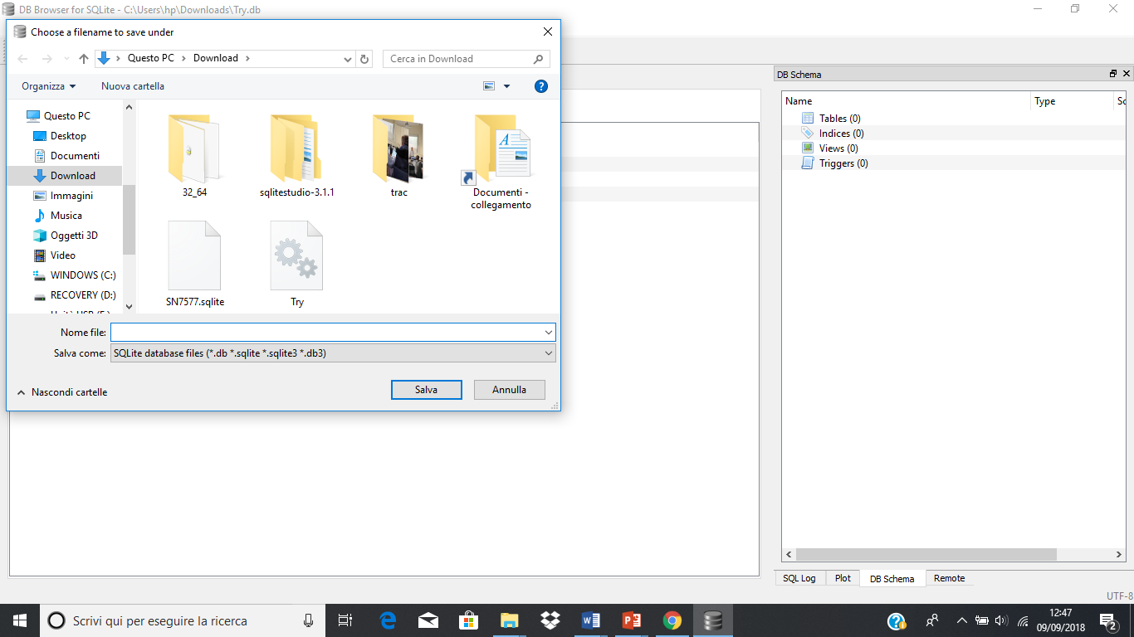
2. Using DB Browser for SQLite
Create a new Database
Write Changes & Revert Changes

Slide 19
2. Using DB Browser for SQLite
Key Points
The DB Browser for SQLite application allows you to connect to an existing database or create a new database
When connected to a database you can create new tables
When connected to a database you can write and run SQL queries and view the results
You can save the results of a query to a file

Slide 20
3. The Select Statement
Questions
What is SQL?
How can I return specific columns from a table?
How can I return specific rows from a table?
Objectives
Define SQL
Explain how SQL is used to access relational database tables
Understand the difference between DDL and DML
Create simple SQL queries to return rows and columns from existing tables
Construct more complex logical expressions for use in where clauses
Return sorted results from a query

Slide 21

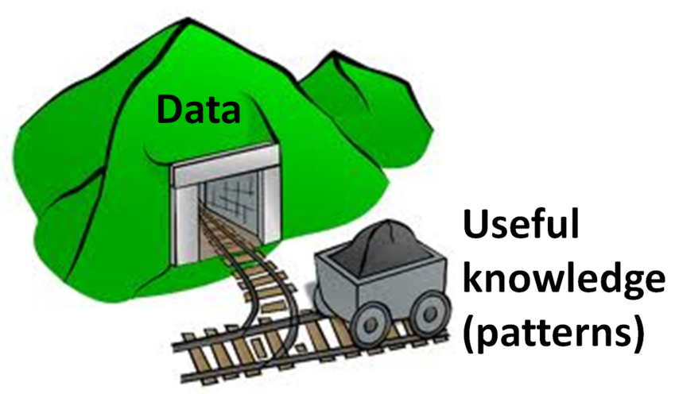
3. The Select Statement
From Data organising
to
Data mining
What is SQL?
SQL or Structured Query Language is an international standard for manipulating data in a relational database. Each Relational Database system like Oracle, MySQL or SQLite implements its own variation of the standard.
For the type of commands and queries that we will want to write, all of the implementations are much in agreement.
Essentially you only have to learn SQL once.

Slide 22
3. The Select Statement
SQL and Relational database tables
The strength of SQL is that a single SQL statement or query can request data be returned from one or many of the tables in the database. You can essentially define the relationships between tables on-the-fly as part of your query statement.
DDL VS DML
DDL stands for Data Definition Language. It is the set of SQL comands used to create alter of delete database objects such as tables.
DML stands for Data Manipulation Language. Principally this is the SELECT command which is used to extract data items from one or more of the database tables.

Slide 23

3. The Select Statement
Simple SQL queries using the Select statement
SQL queries repository
SELECT colnames
FROM tablename
WHERE conditions
GROUP BY colnames
HAVING conditions
ORDER BY colnames

Slide 24

3. The Select Statement
Limiting Result
What if we want to see just the first 5, 10 etc rows
SELECT
Which information I need to visualize
LIMIT
FROM
Where these info are located

Slide 25
3. The Select Statement
Challenge
Write a query that returns the first 5 rows from the Farms table with only the columns Id, B16_year_liv, B17_year_liv, B18_sp_parents_liv, B19_grand_liv, B20_sp_grand_liv.
Solution:
SELECT Id, B16_years_liv, B17_parents_liv, B18_sp_parents_liv, B19_grand_liv, B20_sp_grand_liv
FROM Farms
LIMIT 5;

Slide 26

3. The Select Statement
Filtering
What if you want to see just the data meeting a certain criteria
i.e. certain values or ranges within one or more columns.
Works both for alphanumeric data than for numeric (n this example we are only interested in rows where the value in the B16_years_liv column is greater than 25)
WHERE
Combine more than one condition with AND and OR
Also using brackets to specify priority

Slide 27
3. The Select Statement
BETWEEN or IN operators
SELECT Id, B16_years_liv
FROM Farms
WHERE B16_years_liv BETWEEN 21 AND 29;
SELECT Id, B16_years_liv
FROM Farms
WHERE B16_years_liv > 50 AND B16_years_liv < 60;
SELECT Id, B16_years_liv
FROM Farms
WHERE B16_years_liv IN (51, 52, 53, 54, 55, 56, 57, 58, 59);
N.B. No need to be in order

Slide 28
3. The Select Statement
Challenge
Write a query using the Farms table which returns the columns Id, A09_village, A11_years_farm, B16_years_liv. We are only interested in rows where the A09_village value is either ‘God’ or ‘Ruaca’. Additionally we only want A11_years_farm values in the range 20 to 30 exclusive and B16_years_liv values strictly greater than 40. There are many ways of doing this, but try to use an inequality, an IN clause and a BETWEEN clause.
Solution:
SELECT Id, A09_village, A11_years_farm, B16_years_liv
FROM Farms
WHERE A09_village IN ('God', 'Ruaca')
AND A11_years_farm BETWEEN 21 AND 29
AND B16_years_liv > 40;

Slide 29
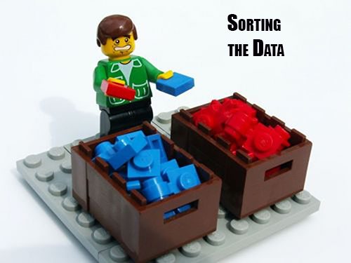
3. The Select Statement
Sorting
We can also sort the results of our queries
How do we want our data to be displayed
ASC
DESC
ORDER BY

Slide 30
3. The Select Statement
Key Points
Strictly speaking SQL is a standard, not a particular implementation
SQL implementation are sufficiently close that you only have to learn SQL once
The DDL concreate tables structs are used to and other database objects
The DML constructs, typically the SELECT statement is used to retrieve data from one or more tables
The SELECT statement allows you to ‘slice’ and ‘dice’ the columns and rows of the dataset so that the query only returns the data of interest

Slide 31
4. Missing Data
Questions
How can I deal with missing data?
Objectives
Recognize what the database sees as missing data
Understand that the original data source may represent missing data differently
Define strategies for dealing with missing data

Slide 32
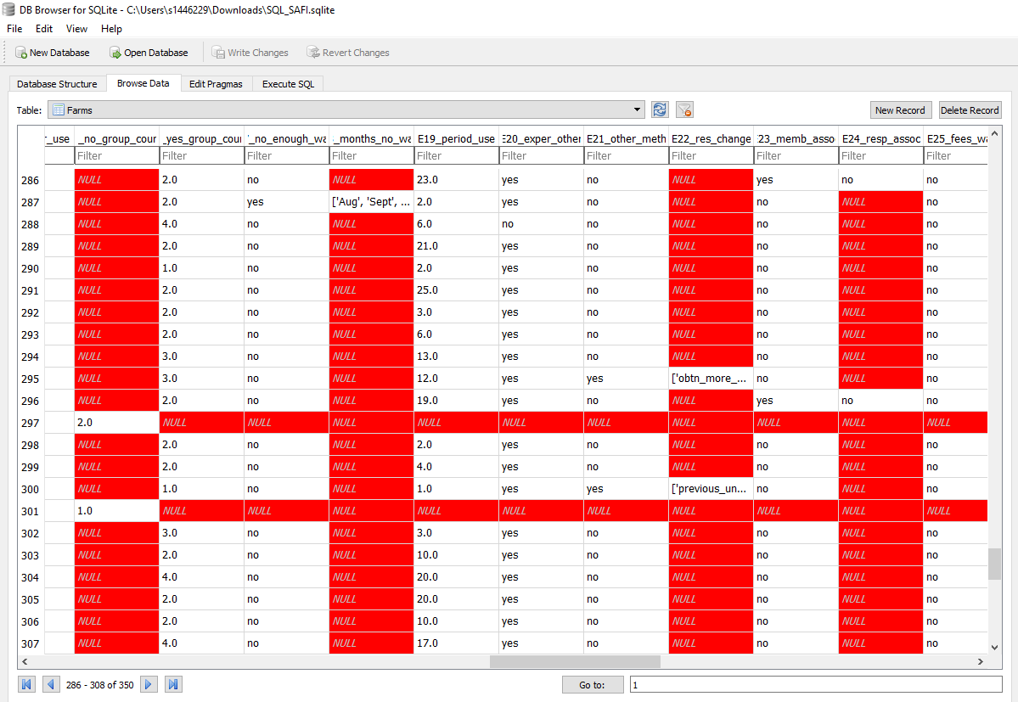
4. Missing Data

Slide 33
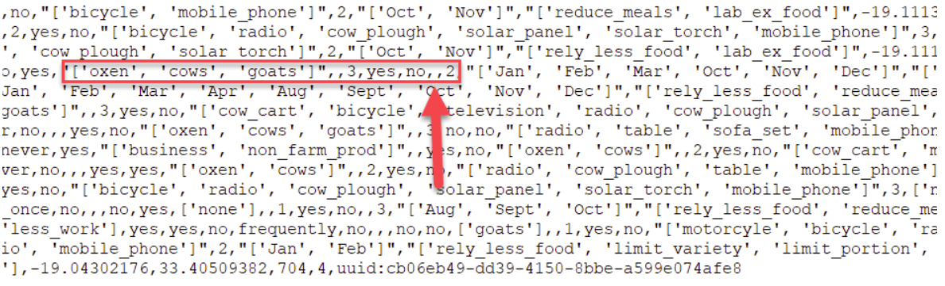
4. Missing Data
The original Csv file
You can see that there are consecutive ‘,’s where the ‘F14_items_owned’ values should be. These values are missing from the data.

Slide 34
4. Missing Data
You may be able to spot from this the relationship between the values in the E01_water_use column and whether or not there is a NULL value in either the E_no_group_count or the E_yes_group_count column.
Only if the Farmer said that they did use water (E01_water_use = ‘yes’) they were asked how many plots they used water on and the value stored in E_yes_group_count otherwise this field was not even presented in the survey and so contains a NULL value. In this situation we expect NULL values and they will not cause any problems.
However the F14_items_owned column records the possessions of the Farmer. This question was always asked. It is not clear from the NULL values we find in this field whether or not it means ‘I have no possessions’ or ‘I do not wish to tell you what possessions I have’, in short, we know nothing about the items owned and therefore the value of NULL is appropriate.

Slide 35
4. Missing Data
Key Points
You should expect missing data
You need to know how missing data is being represented in your dataset
Database systems always represent what they consider to be missing data as NULL
You can explicitly test for NULL values in your data
You may need other tests for different representations of NULL

Slide 36
5. Creating new columns
Questions
How can I add new columns with derived values in the query results?
How can I give a column a new name?
How do I use built-in functions to create new values?
How can I create binned results?
How can I add new columns with derived values in the query results?
How can I give a column a new name?
How do I use built-in functions to create new values?
How can I create binned results?
Objectives
Create new columns in the query output
Rename columns in the query output
Use built-in functions to create new values
Use SQL syntax to conditionally create new values
Use SQL syntax to create a new column of ‘binned’ values

Slide 37
5. Creating new columns
Creating new columns
In addition to selecting existing columns from a table, you can also create new columns in the query output based on the existing columns. These new columns only exist in the output. The table used in the query is not changed in any way.
The Plots table contains a column, D02_total_plot representing the area of the plot and the D03_unit_land column gives the units. In our sample dataset the unit is always ‘hectare’. However in the full dataset some of the plot areas are recorded in ‘acres’. We want to create a new output column which shows the hectare value converted into acres
SELECT D02_total_plot * 2.4701
FROM Plots;

Slide 38

5. Creating new columns
Aliases
As queries get more complex names can get long and unwieldy (as we saw before). To help make things clearer we can use aliases to assign new names to things in the query.
AS
Table names
Column names
SELECT D02_total_plot * 2.4701 AS D02_total_plot_converted
FROM Plots;

Slide 39
5. Creating new columns
Using built-in functions to create new values
In addition to using simple arithmetic operations to create new columns, you can also use some of the SQLite built-in functions. Full details of the available built-in functions are available from the SQLite.org website here.
We will look at some of the arithmetic and statistical functions when we deal with aggregations in a later lesson. For now we will focus on some text functions.
You may have noticed in the output from are last query that the number of decimal places can change from one row to another. In order to make the output more tidy, we may wish to always produce the same number of decimal places , e.g. 2. We can do this using the ROUND function.
The ROUND function works in a similar way as its spreadsheet equivalent, you specify the value you wish to round and the required number of decimal places.

Slide 40

Challenge
5. Creating new columns
Write an SQL query which returns the Id, plot_Id, D01_curr_plot and D02_total_plot columns from the Plots table with the addition of a calculated column representing the plot area in acres and a column representing the units of the calculated column.
SELECT Id, plot_Id, D01_curr_plot, D02_total_plot,
ROUND(D02_total_plot * 2.4701, 2) AS D02_total_plot_converted,
'acres' AS D03_unit_land_converted
FROM Plots;

Slide 41
Substr and Instr
5. Creating new columns
The SUBSTR() used to extract a portion of a string based on a starting position and the number of characters required.
The INSTR() used to check a character or string of characters occurs within another string.
Explanation
The substr function takes 4 characters starting at character 7 from the value A01_interview_date to asses year.
Change the last query to sort by A01_interview_data field and compare the results. What is different?

Slide 42
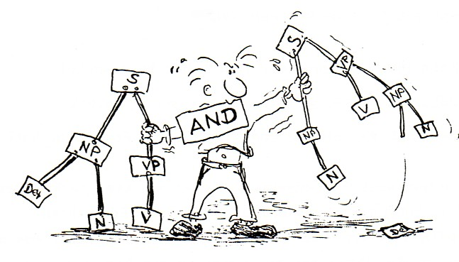
5. Creating new columns
Using SQL syntax to conditionally create new values
The SQLite SQL dialect has a programming construct called the CASE Statment. This is in fact common to many other programming languages as well. It can be used in two different ways, both of which can be used to create new columns in a queries’ result set.
Use to check if various values are equal to the value in the field given after the CASE keyword.
allows you to check if various values are equal to the value in the field given after the case keyword.
SELECT Id, country,
CASE country
WHEN 'Moz' THEN 'Mozambique‘
WHEN 'Taz' THEN 'Tanzania'
ELSE 'Unknown Country'
END AS country_fullname
FROM Farms;

Slide 43

5. Creating new columns
Using SQL syntax to create ‘binned’ values
It is often the case that we wish to convert a continous variable into a an discrete factor type variable. We can use a CASE statement to create this type of effect.
The column A11_years_farm in the Farms table is an indication of how many years the respondent has been on the farm. The values are in years and range from 1 to 60. Instead of using individual years we may want to group these values into ranges like 1-10, 11-20 etc. We can do this using a case statement as part of the SELECT clause
SELECT Id, A11_years_farm,
CASE
WHEN A11_years_farm BETWEEN 1 AND 10 THEN '1-10‘
WHEN A11_years_farm BETWEEN 11 AND 20 THEN '11-20'
WHEN A11_years_farm BETWEEN 21 AND 30 THEN '21-30'
WHEN A11_years_farm BETWEEN 31 AND 40 THEN '31-40'
WHEN A11_years_farm BETWEEN 41 AND 50 THEN '41-50'
WHEN A11_years_farm BETWEEN 41 AND 50 THEN '51-60'
ELSE '> 60'
END AS A11_years_farm_range
FROM Farms;

Slide 44
5. Creating new columns
Key Points
New result columns can be created using arithmetic operators or builtin functions
New columns have to be given names or Alias’
The Case coding structure can be used to create new columns
The new columns are only in the query results. The original table is not changed
previous episode

Slide 45
6. Aggregations
Question
How can I summaries the data in my tables
Objectives
Use the Distinct keyword to get a unique set of values
Use the ‘group by’ clause to summaries data
Use built-in statistical functions to provide column summaries
Use the ‘having’ clause to provide selection criteria to the summary values
Understand the difference between the ‘where’ and the ‘having’ clauses

Slide 46

6. Aggregations
Aggregation allows us to combine results by grouping records based on value and calculating combined values in groups
Calculate and sum all the possible combination of values
MIN | returns the smallest value in a given column
MAX | returns the largest value in a given column
SUM | returns the sum of the numeric values in a given column
AVG | returns the average value of a given column
COUNT | returns the total number of values in a given column
COUNT(*) | returns the number of rows in a table

Slide 47

6. Aggregations
The Distinct keyword
For the SAFI survey, it was know in advance all of the possible values that certain variables of columns could contain. For example the ‘A06_province’, ‘A07_district’, ‘A08_ward’ and ‘A09_village’ variables could only ever contain certain values.
For the ‘A06_province’ there were only three possibilities, but by the time we get down to ‘A09_villages’, a far more specific geography, it would not have been possible to anticipate in advance all of the possible values (village names) and so the values for this field were manually typed in.
To obtain a list of unique values in a particular column we can use the Distinct keyword.
Using the Farms table we will obtain a list of all of the different values of the ‘A06_province’ column contained in the table.
SELECT DISTINCT

Slide 48
6. Aggregations
Challenge
Write a query that will return all of the different combinations of the ‘A06_province’, ‘A07_district’, ‘A08_ward’ and ‘A09_village’ columns in the Farms table.
When looking at the results, you may have noticed that they are not in any sorted order. Re-write the query so that the values of the four columns are returned in alphabetical order.
select distinct A06_province, A07_district, A08_ward, A09_village
from Farms
order by A06_province, A07_district, A08_ward, A09_village;

Slide 49

6. Aggregations
GROUP BY
The GROUP BY statement is often used with aggregate functions (COUNT, MAX, MIN, SUM, AVG) to group the result-set by one or more columns.
You really want to know How many of each of the values there are!
SUMMARISE YOUR DATA
The grouping will take place based on the order of the columns listed in the GROUP BY clause. There will be one row returned for each unique combination of the columns mentioned in the GROUP BY clause

Slide 50
6. Aggregations
Challenge
Write a query which returns the min, max and avg values as well as a count of the number of records involved for the ‘A11_years_farm’ column for each village in the ‘Nhamatanda’ district.
select distinct A06_province, A07_district, A08_ward, A09_village
from Farms
order by A06_province, A07_district, A08_ward, A09_village;

Slide 51

6. Aggregations
HAVING Keyword
Filter the results based on aggregate functions.
E.g. we can request to only return information about number of records involved for the ‘A11_years_farm a count higher than 10
select A08_ward,
min(A11_years_farm) as min_years,
max(A11_years_farm) as max_years,
count(*) as how_many_farms
from Farms
group by A08_ward
having how_many_farms > 2;
The HAVING keyword works exactly like the WHERE keyword, but uses aggregate functions instead of database fields.
If you use AS in your query to rename a column, HAVING can use this information to make the query more readable. For example, in the above query, we can call the COUNT(species_id)by another name, like occurences.

Slide 52
6. Aggregations
x
Challenge 3
Using the Crops table write a query which will list all of the crops (D_curr_crop) which are grown in over 100 plots.
Solution:
select D_curr_crop,
count(*) as how_many
from Crops
group by D_curr_crop
having how_many > 100;

Slide 53
7. creating tables and views
Questions
What is the difference between a table and a view?
How can I create a table using the SQLite?
How can I create a table or view in the SQLite plugin using SQL code?
How can I add records of data to a table?
Objectives
Understand the differences and similarities between Tables and Views
Create table schemas using SQLite
Create table schemas and views using SQL code
Populate a table using SQL code
Populate a table from a file of data using the SQLite plugin GUI

Slide 54
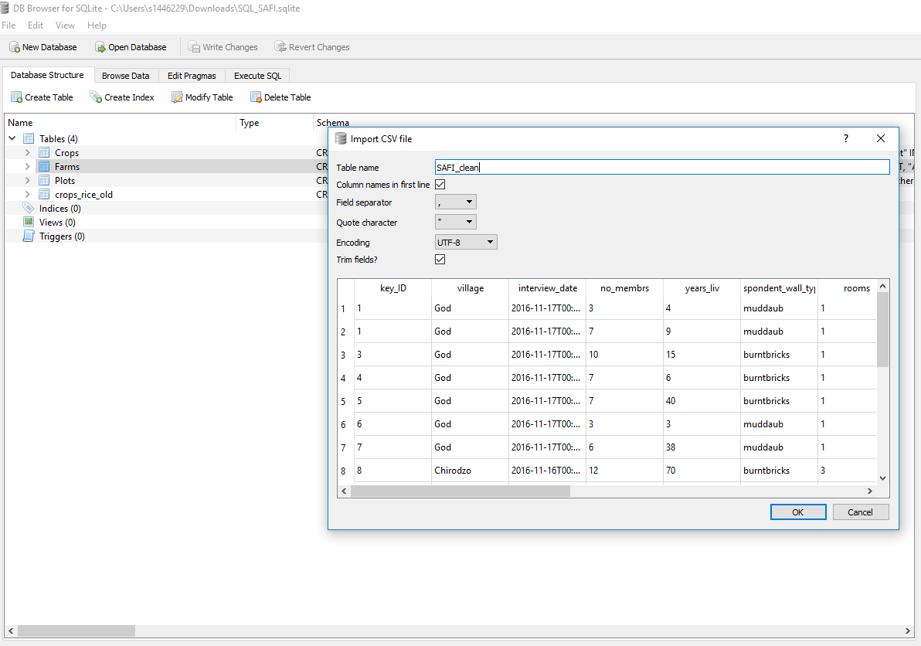
7. creating tables and views
Using DB manager to create a new table

Slide 55
7. creating tables and views
Using the DB Browser application to create tables
What if I already have all my data on excel tables?
For large datasets this is a very common approach to enter them as CSV files and then connect them
From the File menu select Import and then ‘Table from CSV file’. This will start the ‘Import CSV file’ wizard and you will be asked to select the file of data you wish to import from a standard Windows file open dialog.
After you have selected the file, you will be shown the ‘Import CSV file’ window which will allow you to set a name for the table (the default is taken from the filename). You will see the first few rows of the data and there are a few options which can be changed if needs be.

Slide 56
7. creating tables and views
The Import CSV wizard
PK - Or Primary Key, a unique identifier for the row.
AI - Or Auto Increment. This isn’t really applicable to tables created in this way, i.e. the creation of the schema immediatley followed by loading data from a file. It is usally used to generate uniques values for a column which could then act as a primary key
Not Null - If this is checked then it means that there must be a value for each row in this column. In real datasets missing values are quite common and we have already looked at ways of dealing with them when they occur in tables. If you you were check this box and the data did have missing values for this column, the record from the file would be rejected and the load of the file will fail.
U - Or Unique. This allows you to say that the contents of the columnn, which is not the primary key column has to have unique values in it.
Default - This is used in conjunction with ‘Not Null’, if a value is not provided in the dataset, then if provided, the default value for that column will be used.
Check - This allows you to specify a constraint on the vlaues entered for the column. You could restrict the range of values or compare the value with other columns values.

Slide 57
7. creating tables and views
Using SQL code to create tables
In relational databases, tables have to be created before you can add data to them. The table definition that you create is referred to as the Schema of the table.
The schema can contain many different properties of the table and the data that it does/will contain
We will create two simple tables which we will use in a later episode.
Lets create our simple tables first. The code below creates a table called ‘Animals’ with two columns, the first is called ‘Id_A’ and is an Integer and the second is called ‘Name’ and is of type Text.
As this table already exists in the database, it will fail if you try to run the SQL code below, complaining that the table already exists. Instead of running it as-is, change the table name slightly (perhaps include your initials as a prefix).
CREATE TABLE Animal
( Id_A Integer,
Name Text
);

Slide 58
7. creating tables and views
Creating tables from other tables
Whenever you write a Select query and run it, the results are always in the form of a table. In the results pane, you can see the column names and the rows of data in the results.
This provides a very easy way of creating new table based on the results of a query.
The following query selects a few of the columns from the SN7577 table
CREATE TABLE Farms_Location AS
SELECT Id,
Country,
A06_province,
A07_district,
A08_ward,
A09_village
FROM Farms;

Slide 59

7. creating tables and views
Saving Queries for Future Use
imagine that my project only wants to consider a subsample of column
Sometimes you need to repeat the same operation. SQL comes with a very powerful mechanism to do this: views. Views are a form of query that is saved in the database, and can be used to look at, filter, and even update information.
One way to think of views is as a table, that can read, aggregate, and filter information from several places before showing it to you.
SELECT Id, Country, A06_province, A07_district, A08_ward, A09_village
FROM Farms;
CREATE VIEW Farms_location AS
SELECT Id, Country, A06_province, A07_district, A08_ward, A09_village
FROM Farms;
SELECT*
FROM Farms_location
WHERE A09_village = 'God';
CREATE VIEW viewname AS

Slide 60

8. Joins
Questions
What is meant by joining tables?
Why would I want to join tables?
What different types of joins are there?
How do Joins help you discover missing data or gaps in the data
Objectives
Understand the structure of a joined table
Familiarity with the different join types
Use different join types in analysing your data
Understand what other join types can tell you about your
data

Slide 61

8. Joins
Joins
To combine data from two tables we use the SQL JOIN command, which comes after the FROM command.
The JOIN command on its own will result in a cross product, where each row in first table is paired with each row in the second table. Usually this is not what is desired when combining two tables with data that is related in some way.
For that, we need to tell the computer which columns provide the link between the two tables using the word ON. What we want is to join the data with the same species codes.
The two table to be joined need to share a field (normally primary and foreign key respectively)

Slide 62
8. Joins
Which Farms with more than 12 people in the hosehold grow Maize?
-- how many crops of Maize?
select *
from Crops
where D_curr_crop = 'maize';
-- Which farms have more than 12 in the Household
select Id, B_no_membrs
from Farms
where B_no_membrs > 12;
Not User friendly! I will always have to remember what correspond to what

Slide 63
8. Joins
Which Farms with more than 12 people in the household grow Maize?
-- how many crops of Maize?
select *
from Crops
where D_curr_crop = 'maize';
SELECT a.Id, a.B_no_membrs,
b.Id, b.D_curr_crop
FROM Farms AS a
JOIN Crops AS b
ON a.Id = b.Id AND a.B_no_membrs > 12 AND b.D_curr_crop = 'maize';
How do we bring the two together
-- Which farms have more than 12 in the Houshold
select Id, B_no_membrs
from Farms
where B_no_membrs > 12;

Slide 64
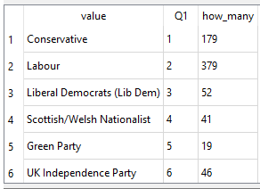
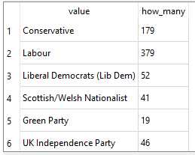
8. Joins
NB Order of execution
Another note for ordering. We don’t actually have to display all the columns of the join.
We can do this because sorting occurs earlier in the computational pipeline than field selection.
The computer is basically doing this:
Filtering rows according to WHERE
Sorting results according to ORDER BY
Displaying requested columns or expressions.

Slide 65
8. Joins
Challenge 1
The output includes the Id column from both tables, how could you have distinguished between them when you wrote the query?
Can you explain why there are two rows for Id 111? Can you change the query so that these two different rows are being correctly displayed?
Solution
select a.Id as Farms_Id, a.B_no_membrs,
b.Id as Crops_Id, b.plot_Id, b.D_curr_crop
from Farms as a
join Crops as b
on a.Id = b.Id and a.B_no_membrs > 12 and b.D_curr_crop = 'maize';

Slide 66

8. Joins
Standard Join
=
INNER JOIN

Slide 67
8. Joins
Joins with more than two tables
Joins are not restricted to just two tables but the more you have the more unreadable the SQL query is, you can create views to hide this complexity.
Our original question was: ‘Which Farms with more than 12 people in the household grow Maize?’ Suppose we now wanted to change the question to be: For Farms with more than 12 people in the household how much land is devoted to growing Maize? we now also need the size of the plots growing maize. This information is only contained in the plots table.
However we cannot join the plots and the crops table with just the plot_id column because the plot_id column is not unique within the Plots table. The plot_id is the plot number within a Farm. So every Farm will have a plot_id with the value 1. In order to make what we join on unique we need to use both the Id column and the plot_id column together. This is allowed and quite commonly done.
Our new query now looks like this:

Slide 68

8. Joins
Challenge 2
1. Modify the query above so that only the ‘Id’, ‘D02_total_plot’ and the ‘D_curr_crop’ columns are shown and at the same time summarise the data so that there is only one entry for each Farm. i.e sum the ‘D02_total_plot’ column.
Solution
SELECT a.Id as Farms_Id,
SUM(b.D02_total_plot) AS total_planted,
c.D_curr_crop
FROM Farms AS a
JOIN Plots AS b
JOIN Crops AS c
ON a.Id = b.Id AND ( b.Id = c.Id and b.plot_id = c.plot_id) AND a.B_no_membrs > 12 AND c.D_curr_crop = 'maize'
GROUP BY a.Id, c.D_curr_crop;

Slide 69
8. Joins
Key Points
Joins are used to combine data from two or more tables.
Tables to be joined must have a column in each which represent the same thing
There are several different types of joins
The Inner join is the most commonly use
You may have to use the other join types to discover missing data or gaps in your data

Slide 70
9. Using DB tables in other environments
Questions
How do I save my query results for use by other programs or applications?
What are and how do I use ODBC applications?
How can I access an SQLite database table from other programming environments?
Objectives
Understand what ODBC is and when it can be used
Construct appropriate connection strings
Appreciate the advantages of using ODBC to access a remote database
Use an ODBC connection from Excel to retrieve data from a database
Use ODBC from Python or other programming environment to retrieve data from a database

Slide 71
9. Using DB tables in other environments
ODBC and advantages of using it
ODBC - Open Database Conectivity (or Connector) is a driver, which allows a database to be connected to an application or program. ODBC drivers are specific to a given database system.
The DB Browser application provides a simple GUI (Graphical User Interface), for development and testing new queries and we have seen how to export using .csv. Using ODBC misses out the middle man (the file of output). The application or program connects directly to the SQLite database, sends it an SQL query, recieves the output from that query and processes the results in an appropriate fashion.
In the case of Excel the tabular results of the query are displayed in a worksheet. For R and Python the results are assigned to a suitable variable from where they can be examined or further processed.
In the following sections we will give examples of using ODBC to connect to Excel and also accessing SQLite from R and Python programs

Slide 72
9. Using DB tables in other environments
Connection strings
A connection string is a list of parameters and their values which explain to the ODBC driver what database you wish to connect to and how you wish to use it (instruction). For some database systems this might involve providing user credentials as well as specifying which particular database you want to access. For our use of SQLite, the connection string is essentially the full pathname and filename of the SQLite database file.
How and where the connection string information is provided depends on the ODBC driver and the application or program being used.

Slide 73
9. Using DB tables in other environments
Connecting to Excel using ODBC
Dedicated wizard
Connecting to R using ODBC
library("RSQLite") dbfile = "C:/Users/pfsmy/OneDrive/UoM/Carpentry/Datasets/SN7577.sqlite" sqlite = dbDriver("SQLite") mydb = dbConnect(sqlite, dbfile) results = dbSendQuery(mydb, "SELECT * FROM SN7577") data = fetch(results) data dbClearResult(results)
Connecting to Phyton using ODBC
import sqlite3 con = sqlite3.connect(r'C:/Users/pfsmy/OneDrive/UoM/Carpentry/Datasets/SN7577.sqlite') cur = con.cursor() cur.execute("SELECT * FROM SN7577") rows = cur.fetchall() for row in rows: print(row) con.close()

Slide 74
9. Using DB tables in other environments
Key Points
ODBC - Open DataBase Connector allows a database to be connected to a program or application
Each database system has its own ODBC connectors
Programs such as Excel allow you to use ODBC to get data from databases
Programming languages such as Python and R provide libraries which facilitate ODBC connections

Slide 75
